Slide 1


Chapter 6
Dynamic Programming
Slides by Kevin Wayne.
Copyright © 2005 Pearson-Addison Wesley.
All rights reserved.

Slide 2
Algorithmic Paradigms
Greed. Build up a solution incrementally, myopically optimizing some local criterion.
Divide-and-conquer. Break up a problem into two sub-problems, solve each sub-problem independently, and combine solution to sub-problems to form solution to original problem.
Dynamic programming. Break up a problem into a series of overlapping sub-problems, and build up solutions to larger and larger sub-problems.
Bellman. Pioneered the systematic study of dynamic programming in the 1950s.
Notes:
overlapping sub-problem = sub-problem whose results can be reused several times

Slide 3
Dynamic Programming Applications
Areas.
  Bioinformatics.
  Control theory.
  Information theory.
  Operations research.
  Computer science: theory, graphics, AI, systems, ….
Some famous dynamic programming algorithms.
  Viterbi for hidden Markov models.
  Unix diff for comparing two files.
  Smith-Waterman for sequence alignment.
  Bellman-Ford for shortest path routing in networks.
  Cocke-Kasami-Younger for parsing context free grammars.

Slide 4
6.1 Weighted Interval Scheduling
Notes:
1-24,26-37

Slide 5
Weighted Interval Scheduling
Weighted interval scheduling problem.
  Job j starts at s_{j}, finishes at f_{j}, and has weight or value v_{j} .
  Two jobs compatible if they don't overlap.
  Goal: find maximum weight subset of mutually compatible jobs.
a
b
c
d
e
f
g
h
Time
0
1
2
3
4
5
6
7
8
9
10
11

Slide 6
Unweighted Interval Scheduling Review
Recall. Greedy algorithm works if all weights are 1.
  Consider jobs in ascending order of finish time.
  Add job to subset if it is compatible with previously chosen jobs.
Observation. Greedy algorithm can fail spectacularly if arbitrary weights are allowed.
weight = 999
b
weight = 1
a
Time
0
1
2
3
4
5
6
7
8
9
10
11

Slide 7
Weighted Interval Scheduling
Notation. Label jobs by finishing time: f₁ ≤ f₂ ≤ . . . ≤ f_{n} .
Def. p(j) = largest index i < j such that job i is compatible with j.
Ex: p(8) = 5, p(7) = 3, p(2) = 0.
1
2
3
4
5
6
7
8
Time
0
1
2
3
4
5
6
7
8
9
10
11

Slide 8
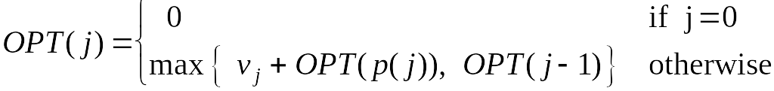
Dynamic Programming: Binary Choice
Notation. OPT(j) = value of optimal solution to the problem consisting of job requests 1, 2, ..., j.
  Case 1: OPT selects job j.
    can't use incompatible jobs { p(j) + 1, p(j) + 2, ..., j - 1 }
    must include optimal solution to problem consisting of remaining compatible jobs 1, 2, ..., p(j)
  Case 2: OPT does not select job j.
    must include optimal solution to problem consisting of remaining compatible jobs 1, 2, ..., j-1
optimal substructure

Slide 9
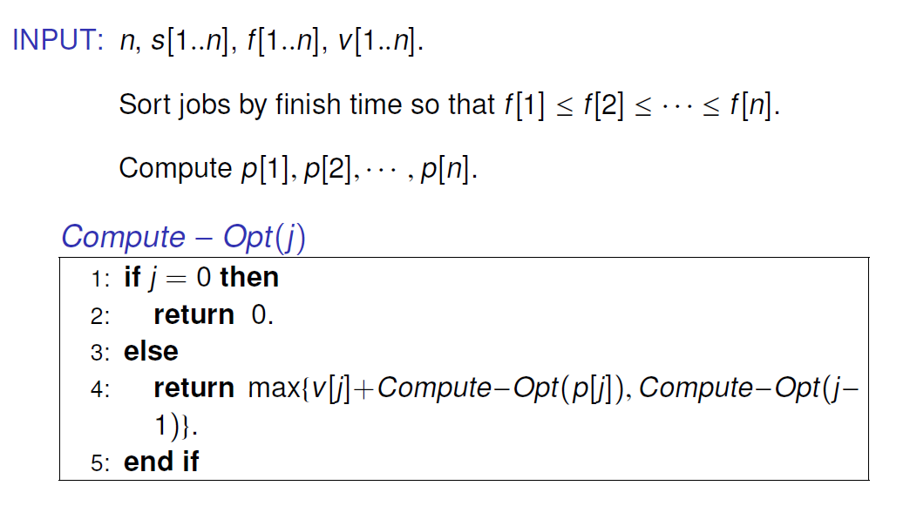
Weighted Interval Scheduling: Brute Force

Slide 10
Weighted Interval Scheduling: Brute Force
Observation. Recursive algorithm fails spectacularly because of redundant sub-problems ⇒ exponential algorithms.
Ex. Number of recursive calls for family of "layered" instances grows like Fibonacci sequence.
5
1
4
3
2
3
3
2
2
1
4
2
1
1
0
1
0
5
p(1) = 0, p(j) = j-2
1
0

Slide 11
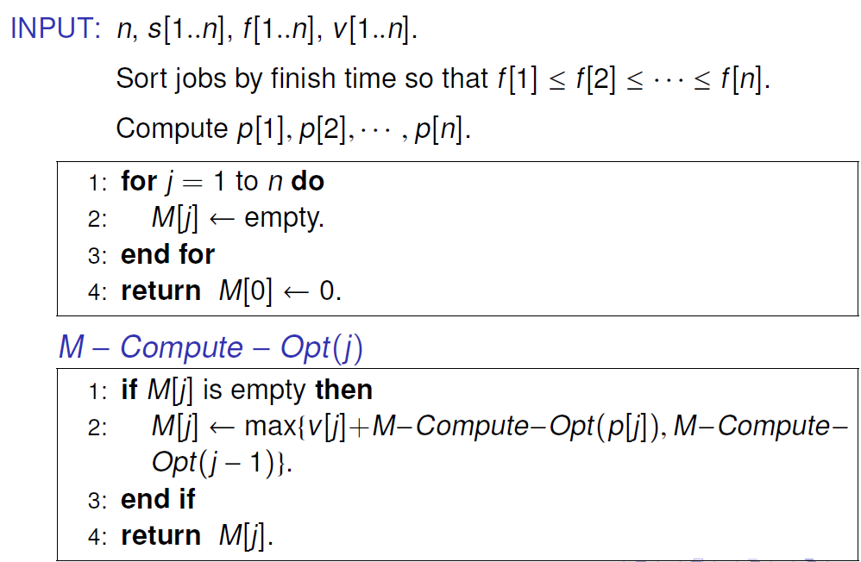
Weighted Interval Scheduling: Memoization
Memoization. Store results of each sub-problem in a cache; lookup as needed.

Slide 12
Weighted Interval Scheduling: Running Time
Claim. Memoized version of algorithm takes O(n log n) time.
  Sort by finish time: O(n log n).
  Computing p(⋅) : O(n logn) via binary search.
  M-Compute-Opt(j): each invocation takes O(1) time and either
    (i) returns an existing value M[j]
    (ii) fills in one new entry M[j] and makes two recursive calls
  Progress measure Φ = # nonempty entries of M[].
    initially Φ = 0, throughout Φ ≤ n.
    (ii) increases Φ by 1 ⇒ at most 2n recursive calls.
  Overall running time of M-Compute-Opt(n) is O(n). ▪

Slide 13
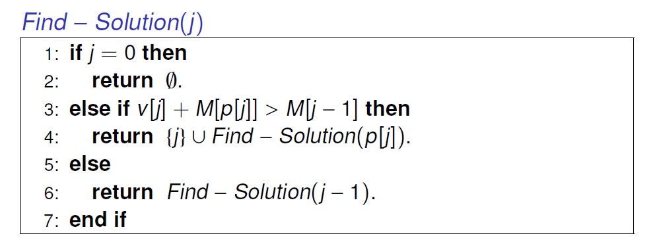
Weighted Interval Scheduling: Finding a Solution
Q. Dynamic programming algorithms computes optimal value. What if we want the solution itself?
A. Do some post-processing.
  # of recursive calls ≤ n ⇒ O(n).

Slide 14
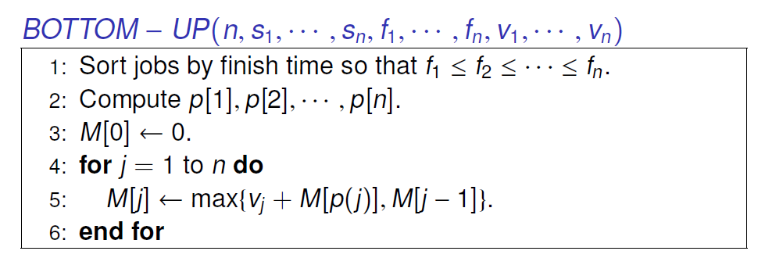
Weighted Interval Scheduling: Bottom-Up
Bottom-up dynamic programming. Unwind recursion.

Slide 15
6.3 Segmented Least Squares
Notes:
1-24,26-37

Slide 16
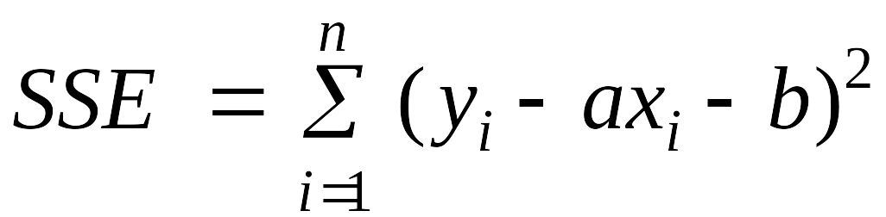
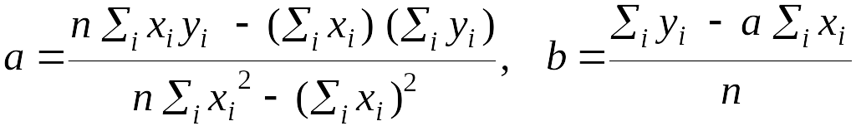
Segmented Least Squares
Least squares.
  Foundational problem in statistic and numerical analysis.
  Given n points in the plane: (x₁, y₁), (x₂, y₂) , . . . , (x_{n}, y_{n}).
  Find a line y = ax + b that minimizes the sum of the squared error:
Solution. Calculus ⇒ min error is achieved when
y
x
Notes:
the term "regression" stems from the work of Sir Francis Galton (1822-1911), a famous geneticist, who studied the heights of fathers and their sons. He found that offspring of a parent of larger than average height tended to be smaller than their parents, and offspring of parents of smaller than average size tended to be larger than their parents. "regression toward mediocrity".
Gauss (1809-1811) used Gaussian elimination to solve multiple linear regression
Gauss-Markov theorem (least squares estimates are uniformly minimum variance estimates (UMVUE) among all linear unbiased estimates)

Slide 17
Segmented Least Squares
Segmented least squares.
  Points lie roughly on a sequence of several line segments.
  Given n points in the plane (x₁, y₁), (x₂, y₂) , . . . , (x_{n}, y_{n}) with
  x₁ < x₂ < ... < x_{n}, find a sequence of lines that minimizes f(x).
Q. What's a reasonable choice for f(x) to balance accuracy and parsimony?
goodness of fit
number of lines
y
x

Slide 18
Segmented Least Squares
Segmented least squares.
  Points lie roughly on a sequence of several line segments.
  Given n points in the plane (x₁, y₁), (x₂, y₂) , . . . , (x_{n}, y_{n}) with
  x₁ < x₂ < ... < x_{n}, find a sequence of lines that minimizes:
    the sum of the sums of the squared errors E in each segment
    the number of lines L
  Tradeoff function: E + c L, for some constant c > 0.
y
x

Slide 19
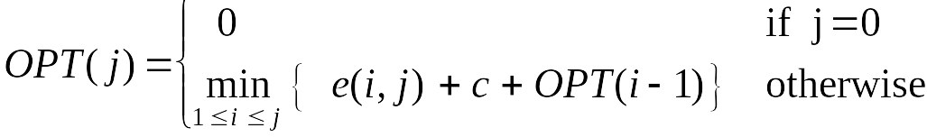
Dynamic Programming: Multiway Choice
Notation.
  OPT(j) = minimum cost for points p₁, p₂ , . . . , p_{j}.
  e(i, j) = minimum sum of squares for points p_{i}, p_{i+1} , . . . , p_{j}.
To compute OPT(j):
  Last segment uses points p_{i}, p_{i+1} , . . . , p_{j} for some i.
  Cost = e(i, j) + c + OPT(i-1).

Slide 20
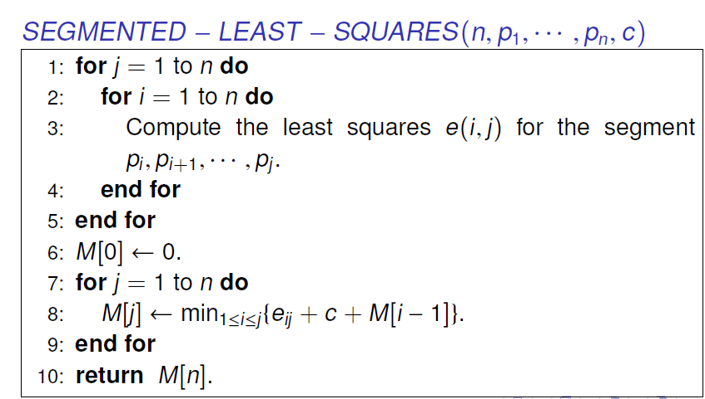
Segmented Least Squares: Algorithm
Running time. O(n³).
  Bottleneck = computing e(i, j) for O(n²) pairs, O(n) per pair using previous formula.

Slide 21
6.4 Knapsack Problem
Notes:
1-24,26-37

Slide 22
Knapsack Problem
Knapsack problem.
  Given n objects and a "knapsack."
  Item i weighs w_{i} > 0 and has value v_{i} > 0.
  Knapsack has capacity of W.
  Goal: fill knapsack so as to maximize total value.
Ex: { 3, 4 } has value 40.
Greedy: repeatedly add item with maximum ratio v_{i} / w_{i}.
Ex: { 5, 2, 1 } achieves only value = 35 ⇒ greedy not optimal.
Item
Value
Weight
1
1
1
2
6
2
W = 11
3
18
5
4
22
6
5
28
7

Slide 23
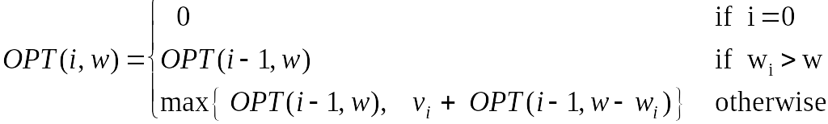
Dynamic Programming: Adding a New Variable
Def. OPT(i, w) = max profit subset of items 1, …, i with weight limit w.
  Case 1: OPT does not select item i.
    OPT selects best of { 1, 2, …, i-1 } using weight limit w
  Case 2: OPT selects item i.
    new weight limit = w – w_{i}
    OPT selects best of { 1, 2, …, i–1 } using this new weight limit

Slide 24
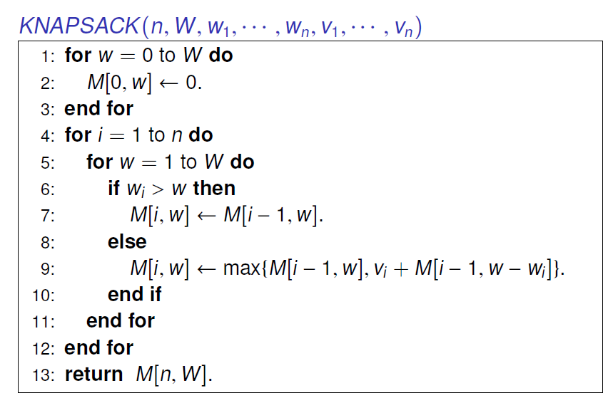
Knapsack Problem: Bottom-Up

Slide 25
Knapsack Algorithm
W + 1
0
1
2
3
4
5
6
7
8
9
10
11
φ
0
0
0
0
0
0
0
0
0
0
0
0
{ 1 }
0
1
1
1
1
1
1
1
1
1
1
1
n + 1
{ 1, 2 }
0
1
6
7
7
7
7
7
7
7
7
7
{ 1, 2, 3 }
0
1
6
7
7
18
19
24
25
25
25
25
{ 1, 2, 3, 4 }
0
1
6
7
7
18
22
24
28
29
29
40
{ 1, 2, 3, 4, 5 }
0
1
6
7
7
18
22
28
29
34
34
40
Item
Value
Weight
1
1
1
OPT: { 4, 3 }
value = 22 + 18 = 40
2
6
2
W = 11
3
18
5
4
22
6
5
28
7

Slide 26
Knapsack Problem: Running Time
Running time. Θ(n W).
  Not polynomial in input size!
  "Pseudo-polynomial."
  Decision version of Knapsack is NP-complete. [Chapter 8]
Knapsack approximation algorithm. There exists a polynomial algorithm that produces a feasible solution that has value within 0.01% of optimum. [Section 11.8]

Slide 27
6.5 RNA Secondary Structure
Notes:
1-24,26-37

Slide 28
RNA Secondary Structure
RNA. String B = b₁b₂…b_{n} over alphabet { A, C, G, U }.
Secondary structure. RNA is single-stranded so it tends to loop back and form base pairs with itself. This structure is essential for understanding behavior of molecule.
Ex: GUCGAUUGAGCGAAUGUAACAACGUGGCUACGGCGAGA
C
A
A
A
A
U
G
C
C
G
U
A
A
G
U
G
A
U
U
A
A
C
G
C
U
G
G
C
G
C
G
A
G
C
G
A
U
complementary base pairs: A-U, C-G
G

Slide 29
RNA Secondary Structure
Secondary structure. A set of pairs S = { (b_{i}, b_{j}) } that satisfy:
  [Watson-Crick.] S is a matching and each pair in S is a Watson-Crick complement: A-U, U-A, C-G, or G-C.
  [No sharp turns.] The ends of each pair are separated by at least 4 intervening bases. If (b_{i}, b_{j}) ∈ S, then i < j - 4.
  [Non-crossing.] If (b_{i}, b_{j}) and (b_{k}, b_{l}) are two pairs in S, then we cannot have i < k < j < l.
Free energy. Usual hypothesis is that an RNA molecule will form the secondary structure with the optimum total free energy.
Goal. Given an RNA molecule B = b₁b₂…b_{n}, find a secondary structure S that maximizes the number of base pairs.
approximate by number of base pairs

Slide 30
RNA Secondary Structure: Examples
Examples.
G
G
G
G
G
C
U
G
G
C
U
C
G
C
G
C
U
A
U
A
U
A
G
U
A
U
A
U
A
base pair
A
U
G
U
G
G
C
C
A
U
A
U
G
G
G
G
C
A
U
A
G
U
U
G
G
C
C
A
U
≤4
ok
sharp turn
crossing

Slide 31
RNA Secondary Structure: Subproblems
First attempt. OPT(j) = maximum number of base pairs in a secondary structure of the substring b₁b₂…b_{j}.
Difficulty. Results in two sub-problems.
  Finding secondary structure in: b₁b₂…b_{t-1}.
  Finding secondary structure in: b_{t+1}b_{t+2}…b_{n-1}.
match b_{t} and b_{n}
1
t
n
OPT(t-1)
need more sub-problems

Slide 32
Dynamic Programming Over Intervals
Notation. OPT(i, j) = maximum number of base pairs in a secondary structure of the substring b_{i}b_{i+1}…b_{j}.
  Case 1. If i ≥ j - 4.
    OPT(i, j) = 0 by no-sharp turns condition.
  Case 2. Base b_{j} is not involved in a pair.
    OPT(i, j) = OPT(i, j-1)
  Case 3. Base b_{j} pairs with b_{t} for some i ≤ t < j - 4.
    non-crossing constraint decouples resulting sub-problems
    OPT(i, j) = 1 + max_{t} { OPT(i, t-1) + OPT(t+1, j-1) }
take max over t such that i ≤ t < j-4 and
b_{t} and b_{j} are Watson-Crick complements

Slide 33
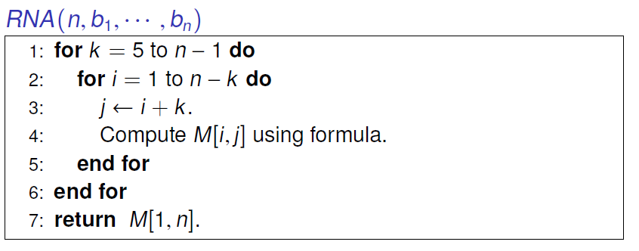
Bottom Up Dynamic Programming Over Intervals
Q. What order to solve the sub-problems?
A. Do shortest intervals first.
Running time. O(n³).
4
0
0
0
3
0
0
i
2
0
1
6
7
8
9
j

Slide 34
Dynamic Programming Summary
Recipe.
  Characterize structure of problem.
  Recursively define value of optimal solution.
  Compute value of optimal solution.
  Construct optimal solution from computed information.
Dynamic programming techniques.
  Binary choice: weighted interval scheduling.
  Multi-way choice: segmented least squares.
  Adding a new variable: knapsack.
  Dynamic programming over intervals: RNA secondary structure.
Top-down vs. bottom-up: different people have different intuitions.

Slide 35
6.6 Sequence Alignment
Notes:
1-24,26-37

Slide 36
String Similarity
How similar are two strings?
  ocurrance
  occurrence
o
c
u
r
r
a
n
c
e
-
o
c
c
u
r
r
e
n
c
e
5 mismatches, 1 gap
o
c
-
u
r
r
a
n
c
e
o
c
c
u
r
r
e
n
c
e
1 mismatch, 1 gap
o
c
-
u
r
r
-
a
n
c
e
o
c
c
u
r
r
e
-
n
c
e
0 mismatches, 3 gaps

Slide 37
Edit Distance
Applications.
  Basis for Unix diff.
  Speech recognition.
  Computational biology.
Edit distance. [Levenshtein 1966, Needleman-Wunsch 1970]
  Gap penalty δ; mismatch penalty α_{pq}.
  Cost = sum of gap and mismatch penalties.
C
T
G
A
C
C
T
A
C
C
T
-
C
T
G
A
C
C
T
A
C
C
T
C
C
T
G
A
C
T
A
C
A
T
C
C
T
G
A
C
-
T
A
C
A
T
α_{TC} + α_{GT} + α_{AG}+ 2α_{CA}
2δ + α_{CA}
Notes:
Levenshtein introduced concept of edit-distance; Needleman-Wunsch first applied it to aligning biological sequences; our algorithm is closest in spirit to Smith-Waterman (but their algorithm is for local alignment)
Presumably alpha_pp = 0, but assumption not needed (could be a profit instead of penalty)
bonus application: spam filter - compare message with known spam messages

Slide 38
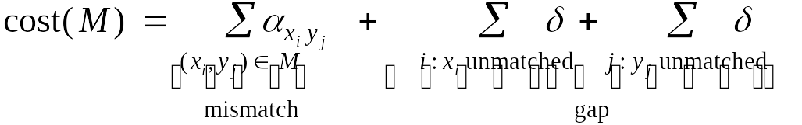
Sequence Alignment
Goal: Given two strings X = x₁ x₂ . . . x_{m} and Y = y₁ y₂ . . . y_{n} find alignment of minimum cost.
Def. An alignment M is a set of ordered pairs x_{i}-y_{j} such that each item occurs in at most one pair and no crossings.
Def. The pair x_{i}-y_{j} and x_{i'}-y_{j'} cross if i < i', but j > j'.
Ex: CTACCG vs. TACATG.
Sol: M = x₂-y₁, x₃-y₂, x₄-y₃, x₅-y₄, x₆-y₆.
x₁
x₂
x₃
x₄
x₅
x₆
C
T
A
C
C
-
G
-
T
A
C
A
T
G
y₁
y₂
y₃
y₄
y₅
y₆

Slide 39
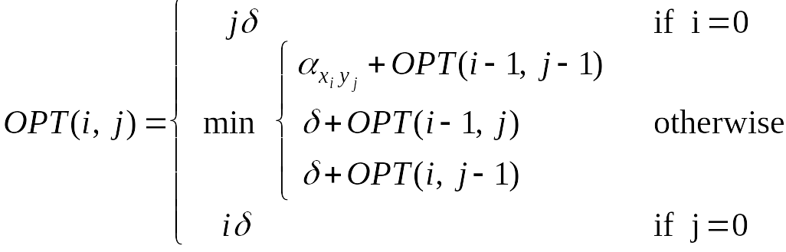
Sequence Alignment: Problem Structure
Def. OPT(i, j) = min cost of aligning strings x₁ x₂ . . . x_{i} and y₁ y₂ . . . y_{j}.
  Case 1: OPT matches x_{i}-y_{j}.
    pay mismatch for x_{i}-y_{j} + min cost of aligning two strings
    x₁ x₂ . . . x_{i-1} and y₁ y₂ . . . y_{j-1}
  Case 2a: OPT leaves x_{i} unmatched.
    pay gap for x_{i} and min cost of aligning x₁ x₂ . . . x_{i-1} and y₁ y₂ . . . y_{j}
  Case 2b: OPT leaves y_{j} unmatched.
    pay gap for y_{j} and min cost of aligning x₁ x₂ . . . x_{i} and y₁ y₂ . . . y_{j-1}

Slide 40
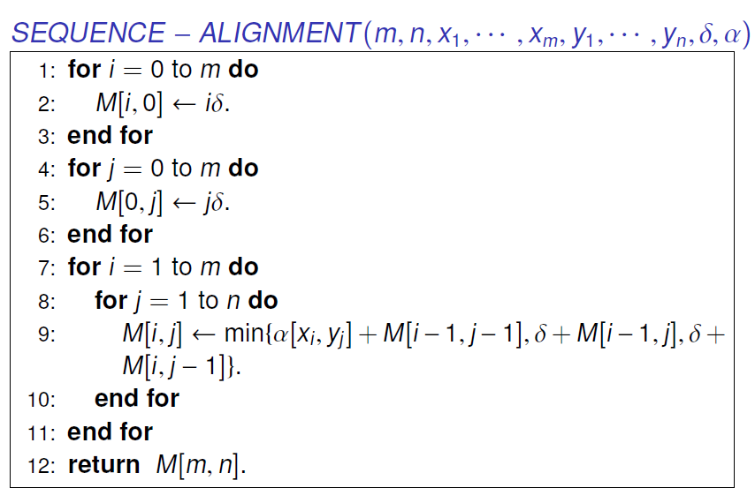
Sequence Alignment: Algorithm
Analysis. Θ(mn) time and space.

Slide 41
6.7 Shortest Paths

Slide 42
Shortest Paths
Shortest path problem. Given a directed graph G = (V, E), with edge weights c_{vw}, find shortest path from node s to node t.
Ex.
allow negative weights
2
10
3
s
9
6
18
-16
6
6
30
11
4
19
15
5
-8
6
20
16
7
44
t

Slide 43
Shortest Paths: Failed Attempts
Dijkstra. Can fail if negative edge costs.
Re-weighting. Adding a constant to every edge weight can fail.
u
2
3
s
v
1
-6
t
5
5
2
2
s
6
t
6
3
0
3
-3

Slide 44
Shortest Paths: Negative Cost Cycles
Negative cost cycle.
Observation. If some path from s to t contains a negative cost cycle, there does not exist a shortest s-t path; otherwise, there exists one that is simple.
-6
-4
7
s
t
W
c(W) < 0

Slide 45
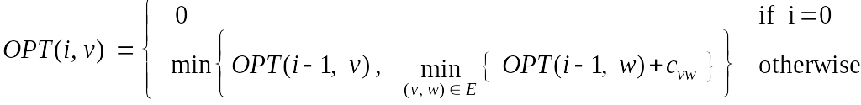
Shortest Paths: Dynamic Programming
Def. OPT(i, v) = length of shortest v-t path P using at most i edges.
  Case 1: P uses at most i-1 edges.
    OPT(i, v) = OPT(i-1, v)
  Case 2: P uses exactly i edges.
    if (v, w) is first edge, then OPT uses (v, w), and then selects best w-t path using at most i-1 edges
Remark. By previous observation, if no negative cycles, then
OPT(n-1, v) = length of shortest v-t path.

Slide 46
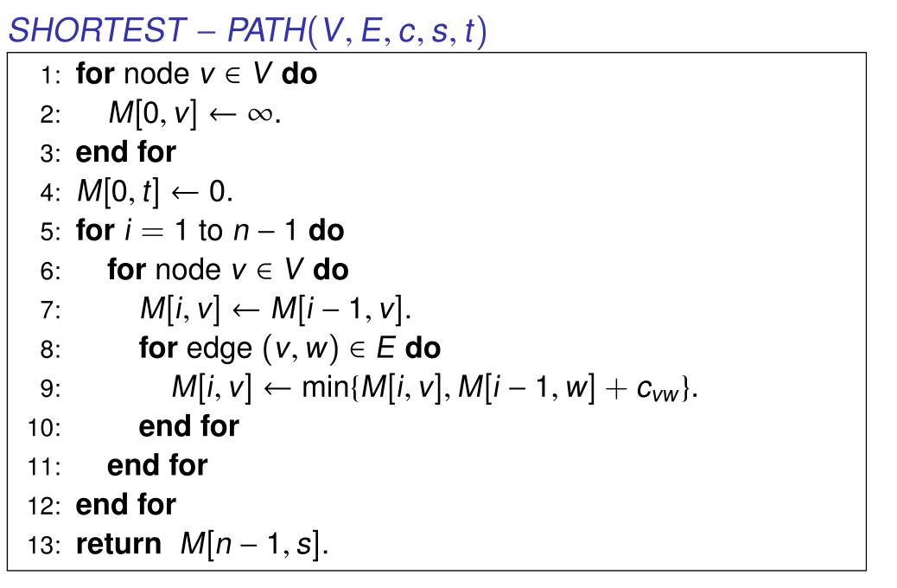
Shortest Paths: Implementation
Analysis. Θ(mn) time, Θ(n²) space.
Finding the shortest paths. Maintain a "successor" for each table entry.
Notes:
Alternative to maintaining predecessor indices: compute optimal distances, then consider only zero reduced cost edges.

